Slide 1

interest rates: are they the crystal ball?

Slide 2
Objectives
ELVALUATE A TIMEFRAME WHERE THERE ARE HIGH AND LOW INTEREST RATE LEVELS
REVIEW TECHNOLOGY SECTOR AND THE TOP 5 TECHNOLOGY COMPANIES DURING THE DESIGNATED TIMEFRAME
REVIEW THE HOUSING MARKET DURING THE DESIGNATED TIMEFRAME
EVALUATE ANY CORRELATIONS IN DATA
IDENTIFY POSSIBLE INVESTING OR TRADING STRATEGIES

Slide 3
Background
WHAT ARE INTEREST RATES?
WHY ARE FEDERAL INTEREST RATES IMPORTANT?
HOW DO THEY EFFECT THE ECONOMY?
Notes:
In the recent years, there has been economic ambiguity and uncertainty, interest rates have been steadily climbing to prevent and economic recession and collapse. As a result of this consistent increase, there has been hardships on much of the nation with rising prices much of everything. With the respect of this project we will be evaluating how these rising interest rates effect the technology and housing sector. In this evaluation, we seek to determine if interest rates are the leading or lagging indicator. Additionally, see if there is investing strategies with the results.
The interest rate is the amount lenders charge borrowers and is a percentage of the principal
The federal funds rate is the target interest rate set by the Fed at which commercial banks borrow and lend their extra reserves to one another overnight.
In the United States, the federal funds rate is the interest rate at which depository institutions lend reserve balances to other depository institutions overnight on an uncollateralized basis.
The federal discount rate is the interest rate the Fed charges on loans. It is not to be confused with the federal funds rate
When interest rates are rising, both businesses and consumers will cut back on spending. This will cause earnings to fall and stock prices to drop. Increasing the bank rate is like a lever for slowing down inflation. By raising it, people should, in theory, start to save more, which will push down demand for goods and services and lead to lower prices.
The discount rate is the rate at which the central bank lends to banks as a lender of last resort.

Slide 4
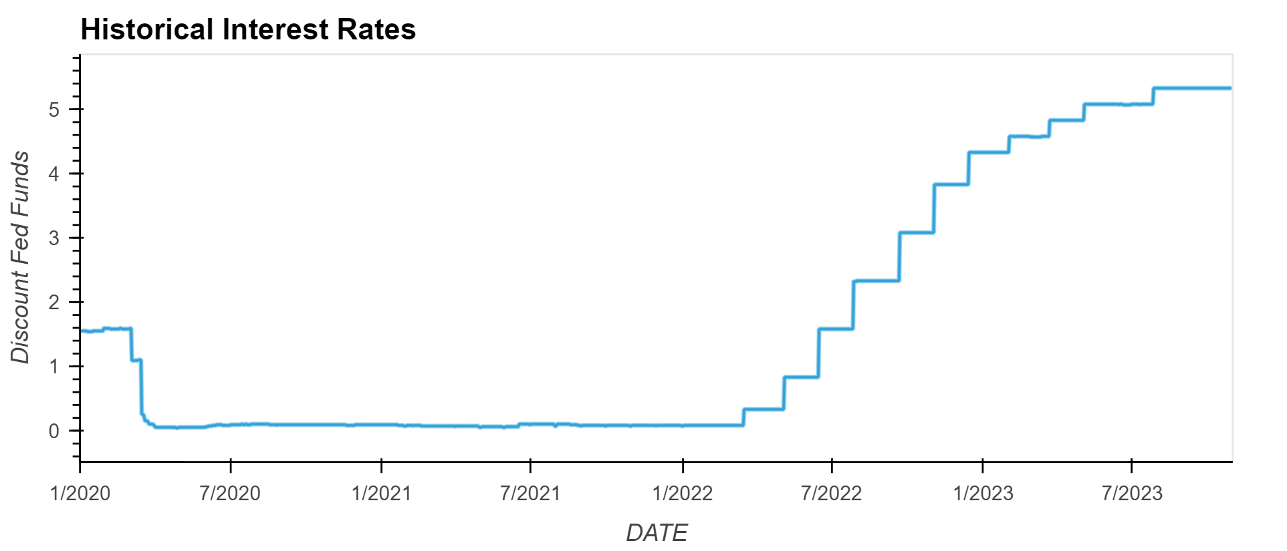
INTEREST RATES
HIGH
LOW

Slide 5
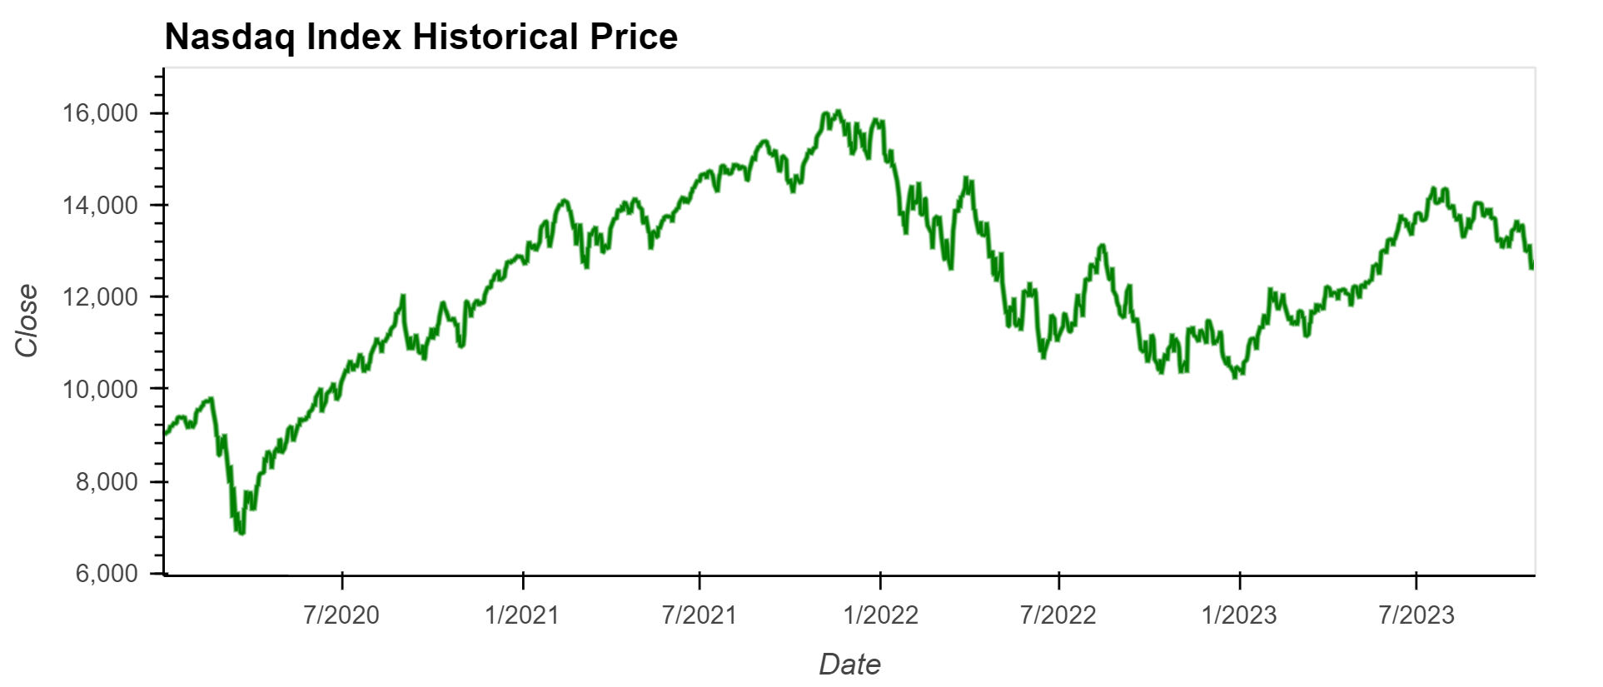
TECHNOLOGY SECTOR: price

Slide 6
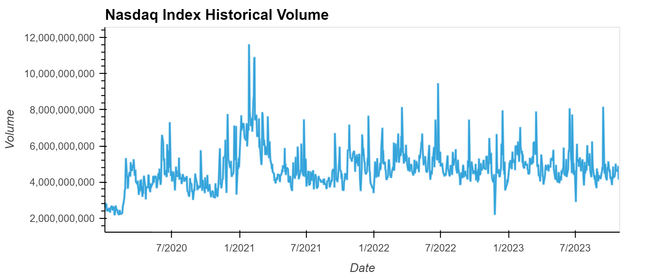
Technology sector: Volume

Slide 7
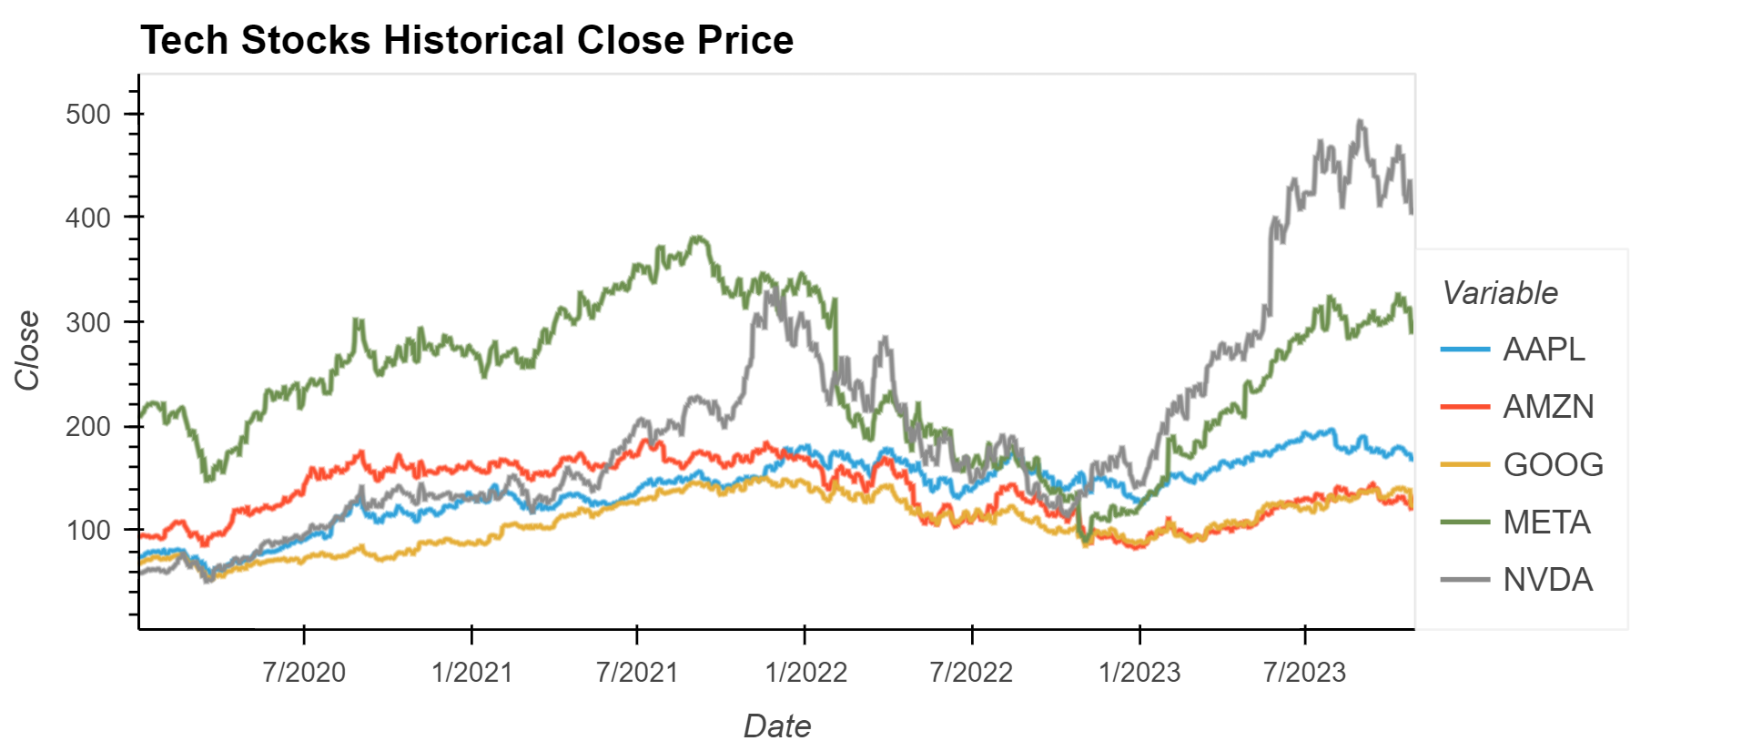
TOP 5 Tech Stocks: Price

Slide 8
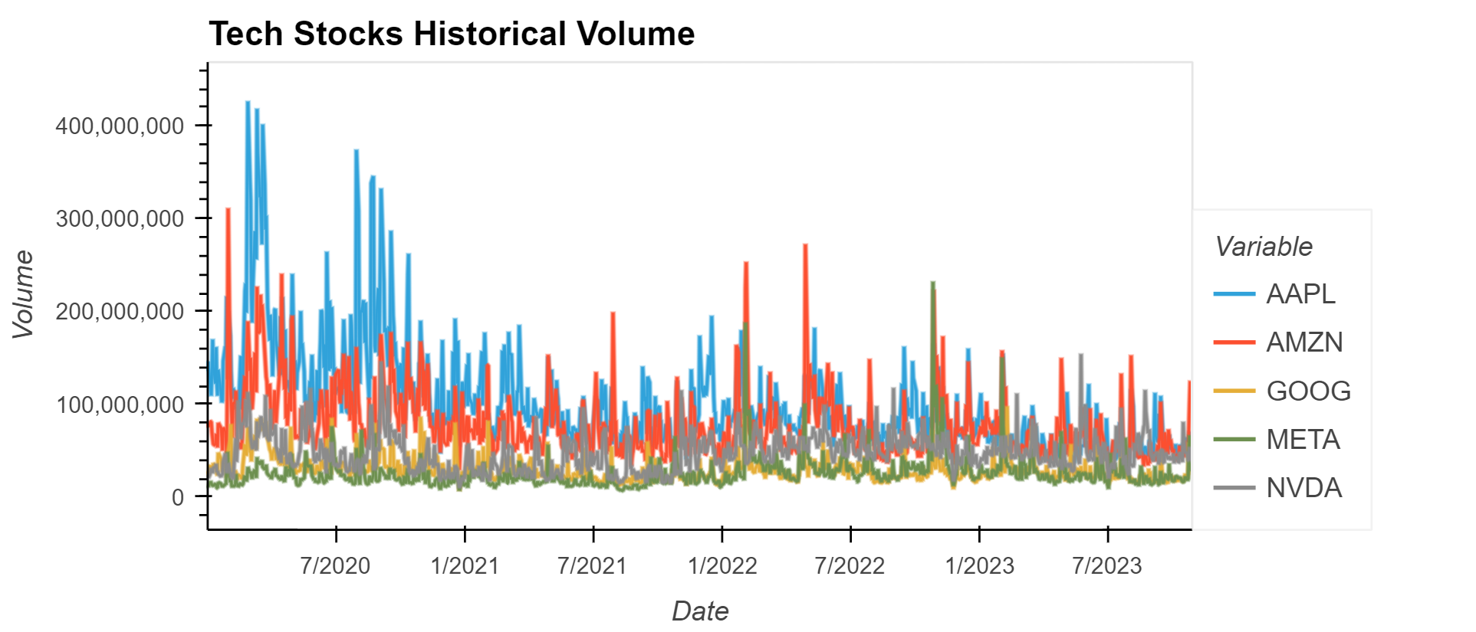
Top 5 tech stocks: Volume

Slide 9
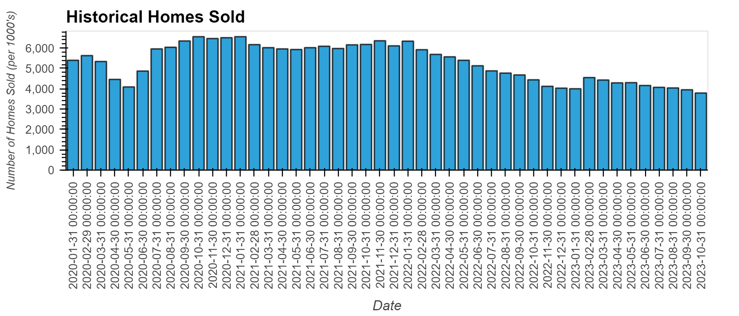
HOUSING MARKET: NUMBER OF UNTIS SOLD

Slide 10

RESULTS

Slide 11
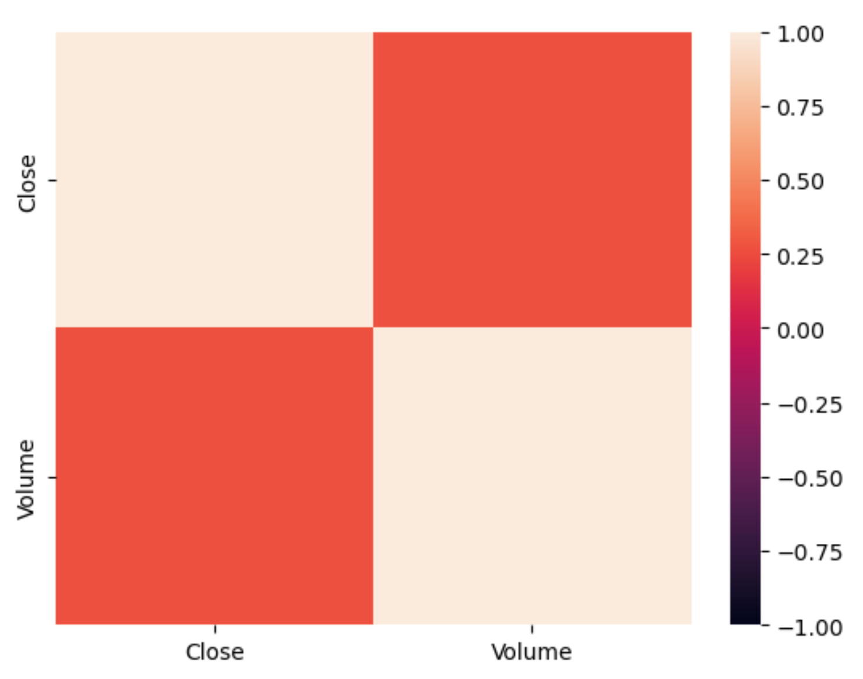
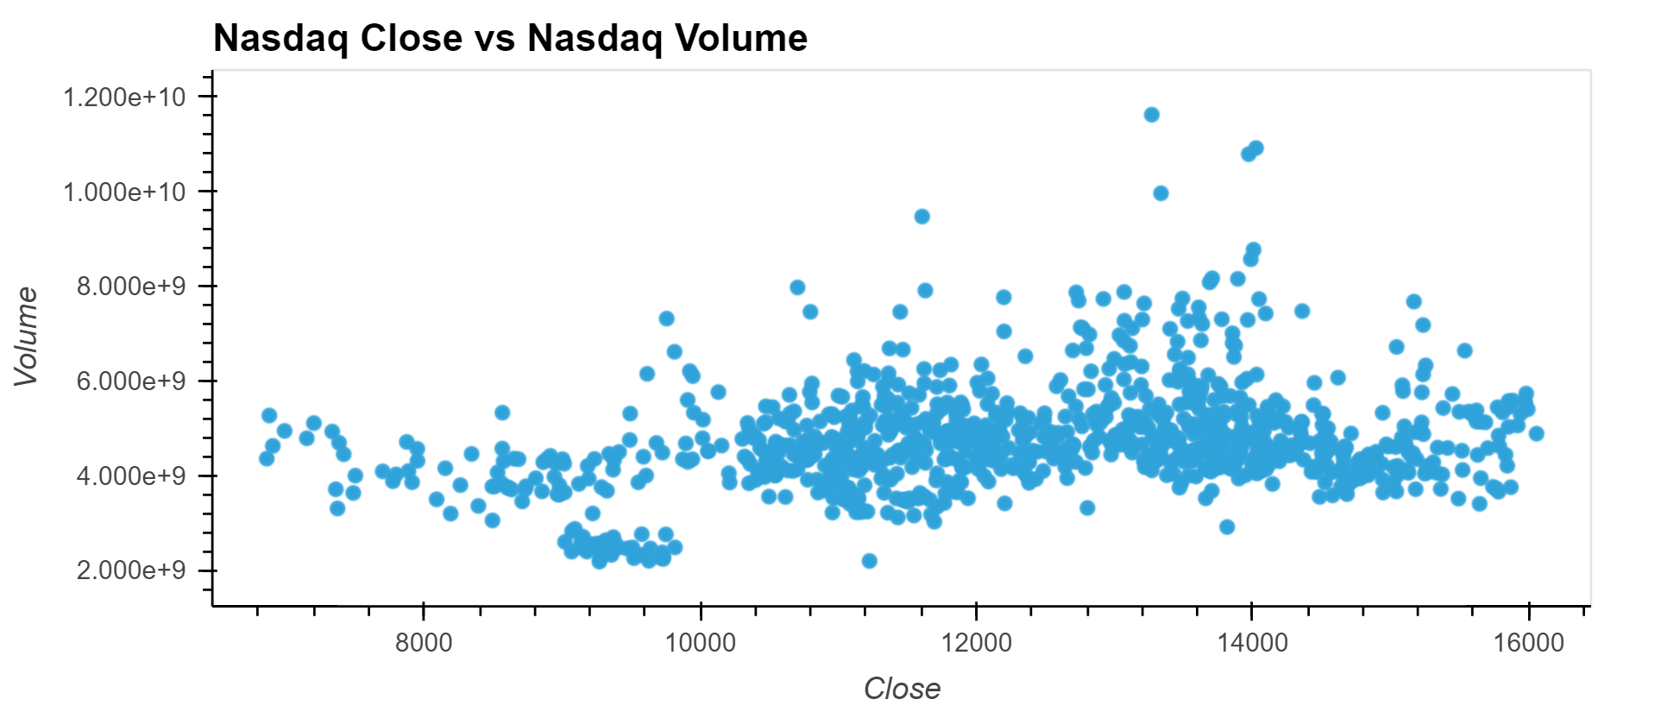
NO CORRELATION

Slide 12
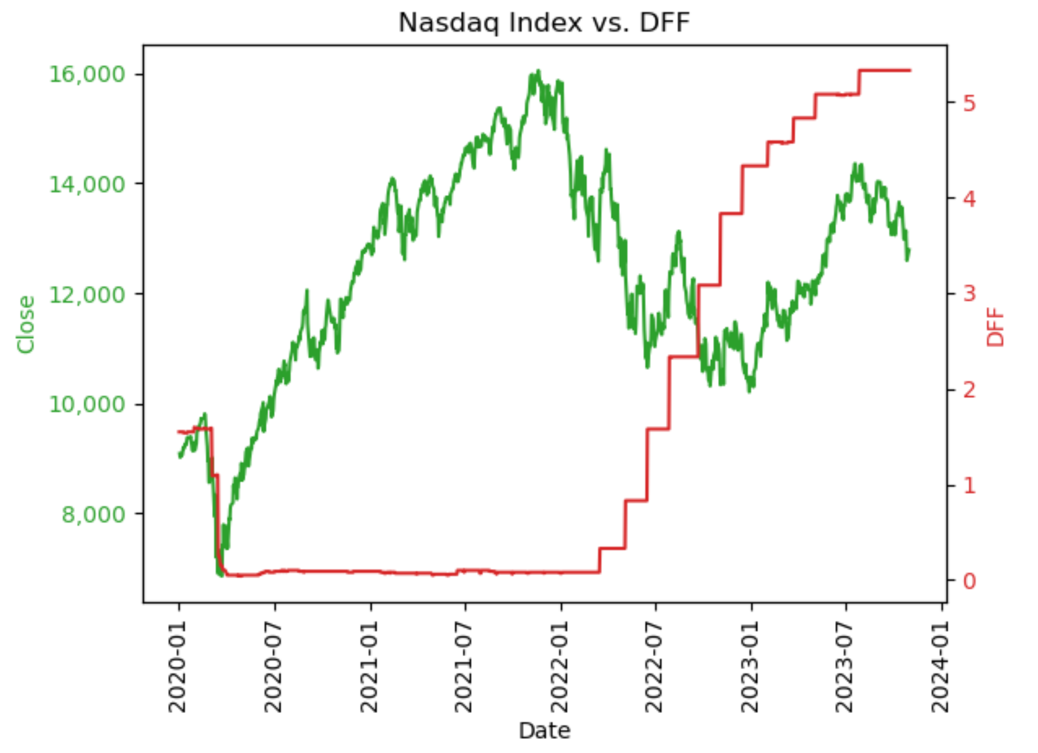
Comparison overlay Graph: Nasdaq vs DFF

Slide 13
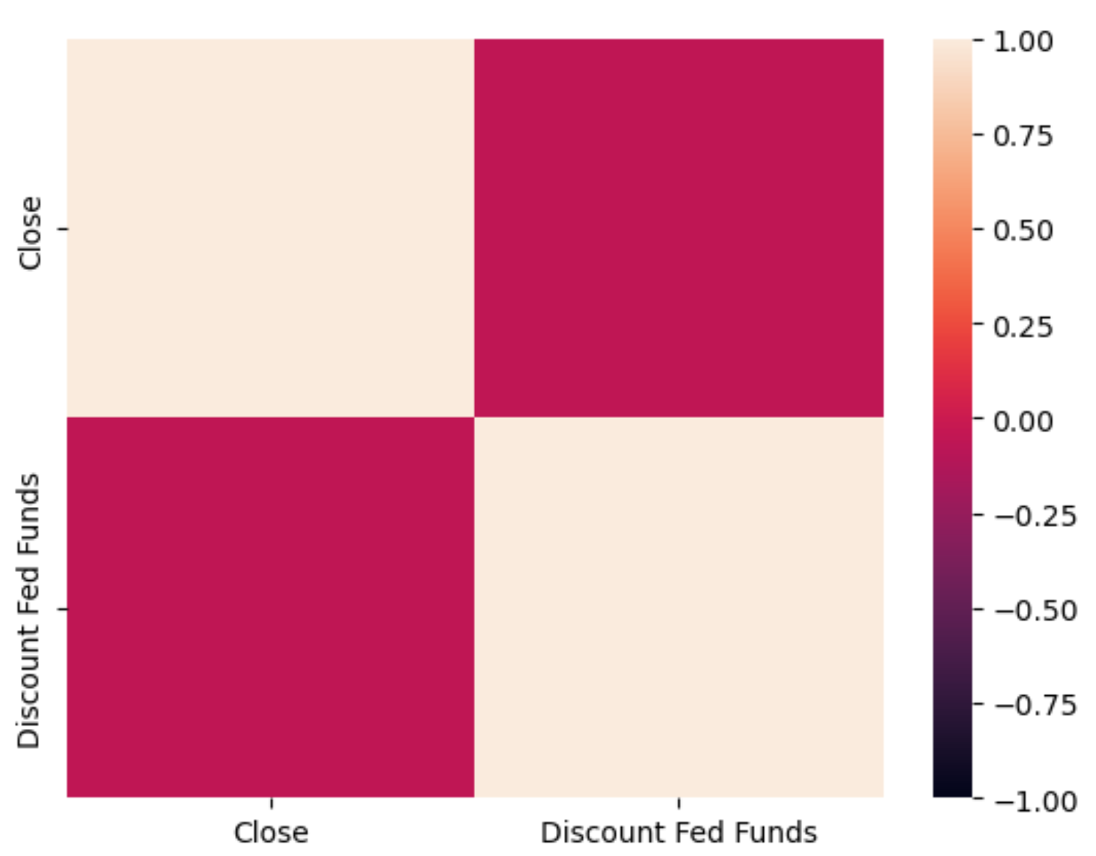
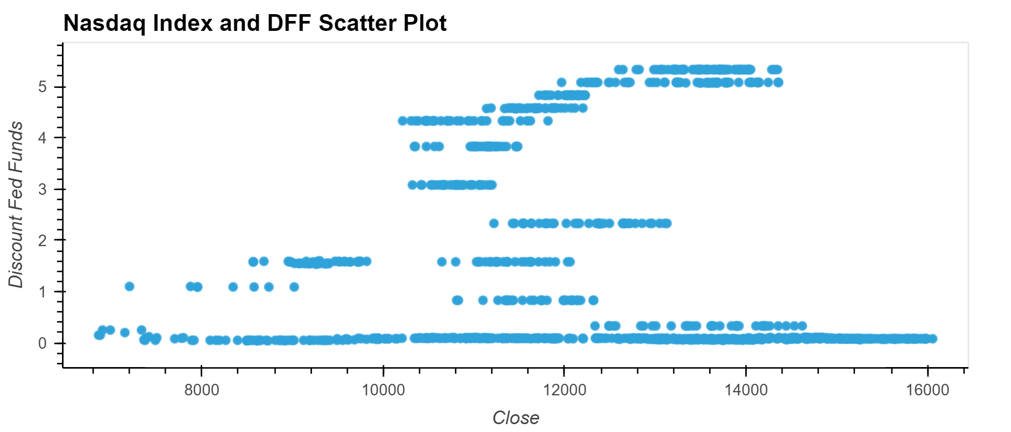
No Correlation

Slide 14
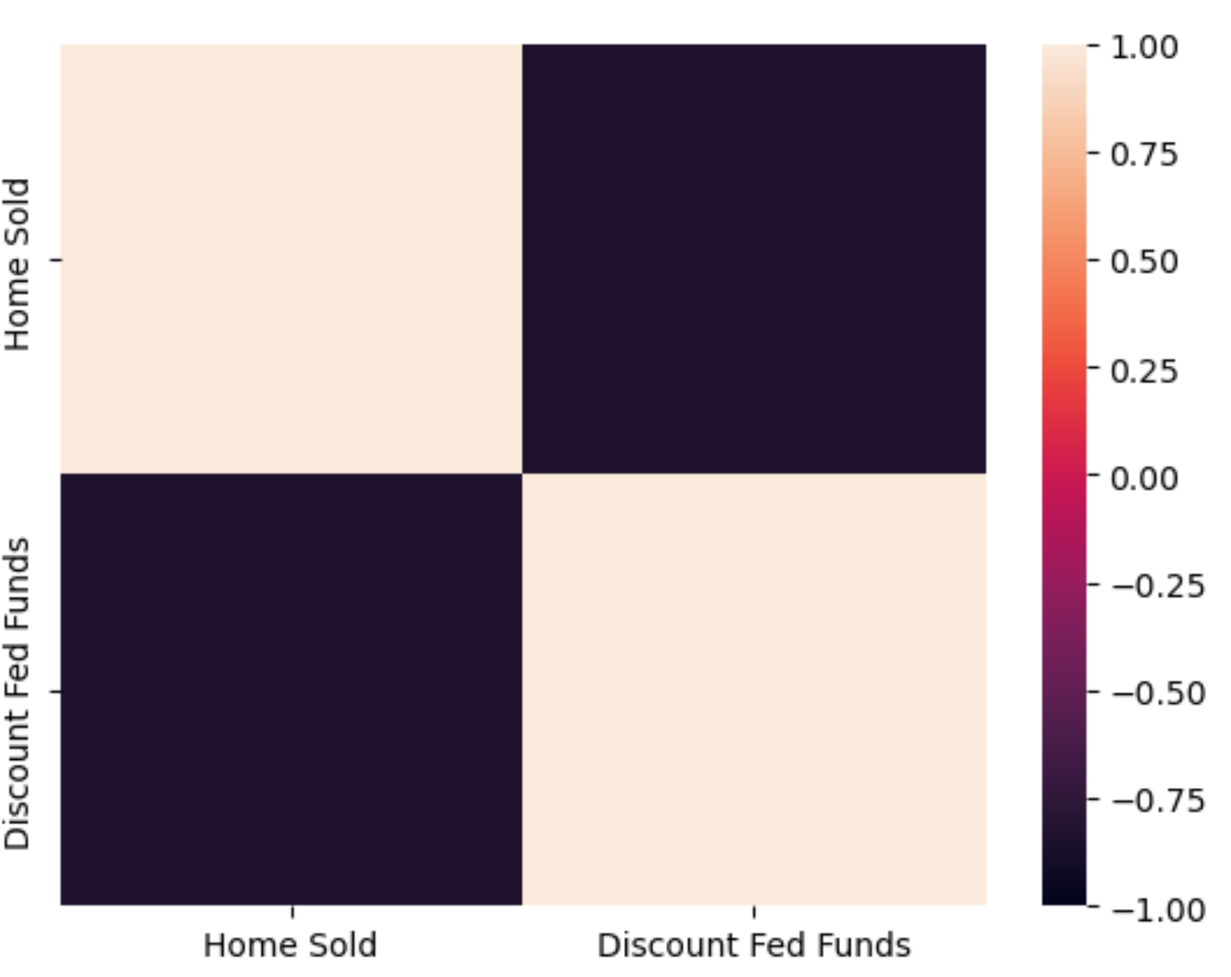
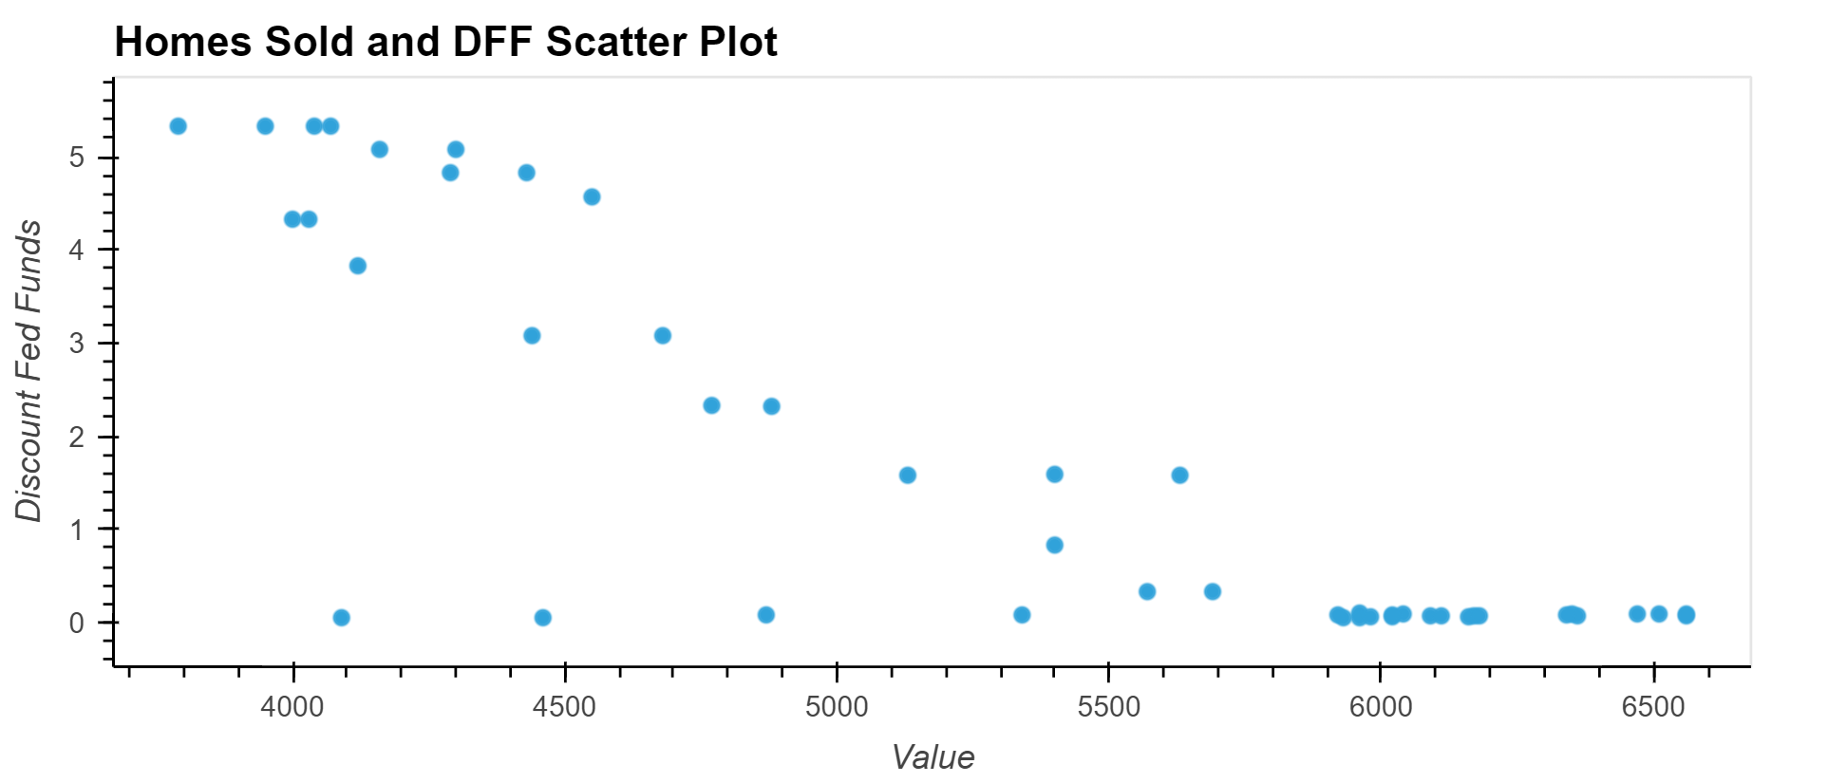
Correlation

Slide 15
CONCLUSION
Interest rates did not have the effect as initially thought
Interest rates did not have an apparent correlation with the technology sector; however, visually the interest rates seemed to influence the Nasdaq index
Interest rates had a correlation to housing market (inverse relationship to homes sold)
Notes:
Only possible investment strategy would be real estate investment for the data results.

Slide 16

NEXT STEPS
Notes:
Select different timeframe to determine if the results are the same
Further investigate housing market for investment strategies
Look at individual stocks and compare to specific bank loans

